Slide 1

PLANNING AT GREEN MILLS
Business data analytics

Slide 2
Team Members
Aastha Dineshsingh Kshatriya ​( 032179860 )
Ajay Balasaheb Tupe​ ( 032188167 )
Akshaya Tonde ( 032258718 )
Musharraf Shaikh​ ( 031878923 )
Sourya Sukul ( 032202597 )​

Slide 3
Problem Statement
Aim: Find the best lowest value for the total cost of production using optimization techniques and Simplex LP
Create a spreadsheet model to compare the costs of three strategies: Chase, Level, and Optimal.
Chase: Produce the exact forecasted demand monthly using regular time only, no overtime or spot market.
Level: Keep 20 employees constant, meet demand using current capacity, and utilize overtime or spot market if needed.
Optimal: Consider all variables (hiring, laying off, regular time, overtime, spot market) to find the best solution.

Slide 4
Key Factors
Regular Time Labor Cost: $200 per thousand board feet.
Overtime Labor Cost: $250 per thousand board feet (limited to 25% of normal working hours).
Hiring and Laying Off Costs: $4,000 and $2,000 per employee, respectively.
Inventory Holding Costs: $25 per thousand board feet.
Spot Market Purchasing Cost: $400 per thousand board feet
Shipping Cost: $50 per thousand board feet.

Slide 5
Assumptions
Monthly demand is given.
Production decisions are made at the beginning of each month.
Lead time for harvesting and shipping is one month, and it is ignored for this analysis.
Shipping capacity is ignored for the calculations to lessen the constraints.

Slide 6
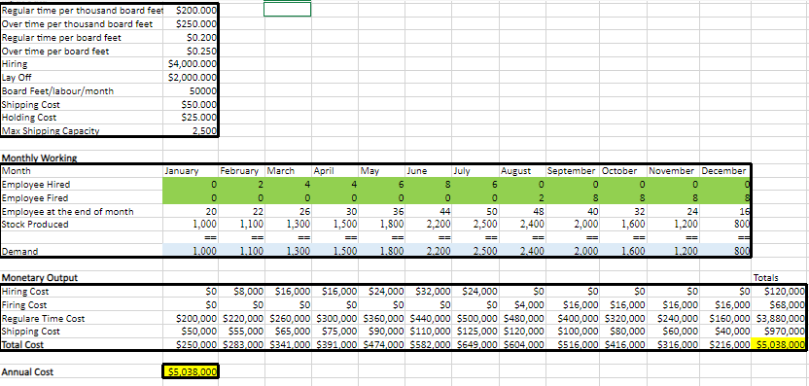
CHASE MODEL

Slide 7
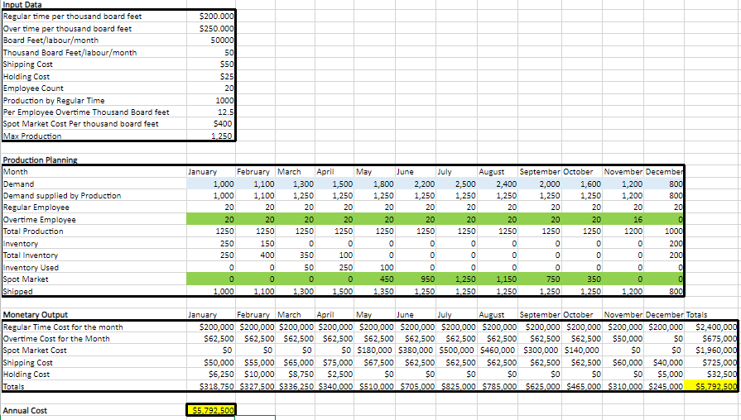
LEVEL MODEL

Slide 8
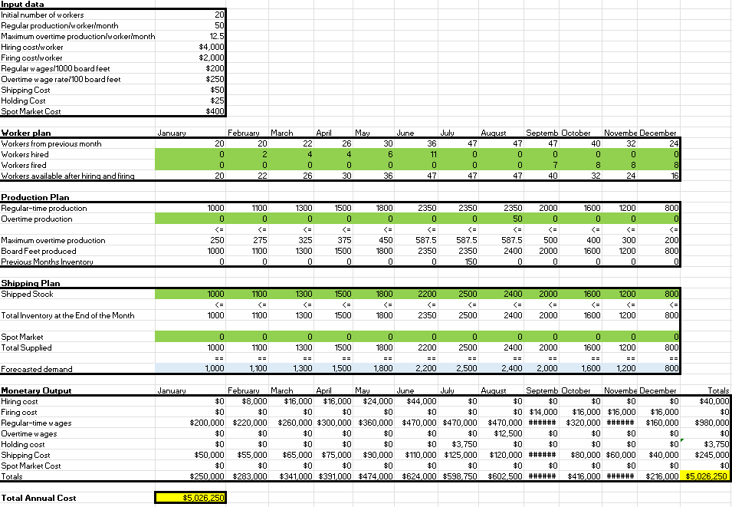
OPTIMAL MODEL

Slide 9
FINDINGS
Chase strategy
This strategy exhibits hiring costs and shipping costs.
This analysis underscores the importance of aligning workforce and production strategies with demand to control costs effectively.
Prioritizing regular time over overtime, optimizing workforce management, and refining production efficiency can contribute to cost savings.
Continuous monitoring and adjustments will be essential for long-term financial sustainability
The Level strategy
With its fixed workforce, might mitigate hiring and laying off costs but could face increased overtime and spot market expenses.
Inventory management is well-handled, minimizing excess inventory and maximizing its utilization.
The strategic reduction in overtime employees towards the end of the year reflects an adaptive workforce strategy.
Spot market purchases are significant in months with high demand, contributing to a substantial portion of the annual cost.
Optimal strategy
It aims to strike a balance by considering all variables, providing potential cost savings.
It provides insights into the production and financial strategy, highlighting areas for potential improvement and optimization.
Regular monitoring and adjustments are essential to align the strategy with changing market conditions and business performance.

Slide 10
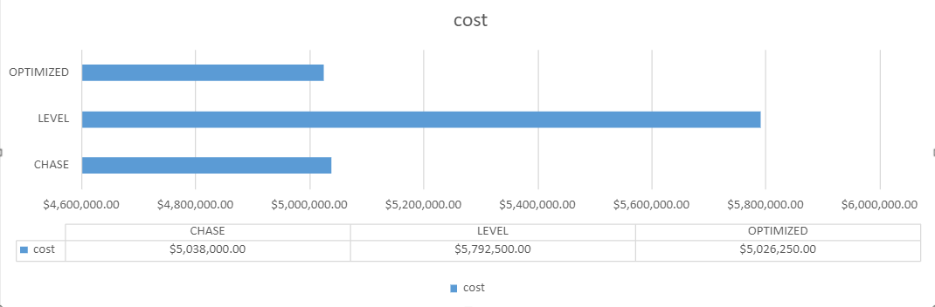
Analysis

Slide 11
Recommendations
Optimal Strategy:
Particulars | Cost in Dollars
Hiring Cost Per Person | 4,000
Maximum production cost per worker considering the maximum monthly production of 50,000 board feet | 10,000
Maximum production cost per worker considering the maximum month overtime production of 12500 board feet | 3,125
Shipping Cost of 50,000 Board feet | 2,500
Shipping Cost of 12500 Board feet | 625
Firing Cost per labour | 2,000
Total | 22,250
Particulars | Cost in Dollars
Spot market cost per thousand Board Feet | 400
The total cost of purchasing 62500 board feet | 25,000

Slide 12
Conclusion
We aim to equip Green Mills with insights that will enable sound decision-making in the face of variable market demands.
Based on the analysis we suggest avoiding the spot market purchase to optimize the cost and spread own products in the market.
Excel spreadsheet offers a thorough cost breakdown for optimal strategy which can be helpful in the future even if the market condition and demand changes.

Slide 13

Q & A

